Slide 2




What is OhioMeansJobs?
OhioMeansJobs is Ohio’s Workforce Development efforts
  Managed by the Ohio Department of Jobs and Family Services
Components
  OhioMeansJobs.com website and mobile app
  Funding and guiding agency for local areas

Slide 3
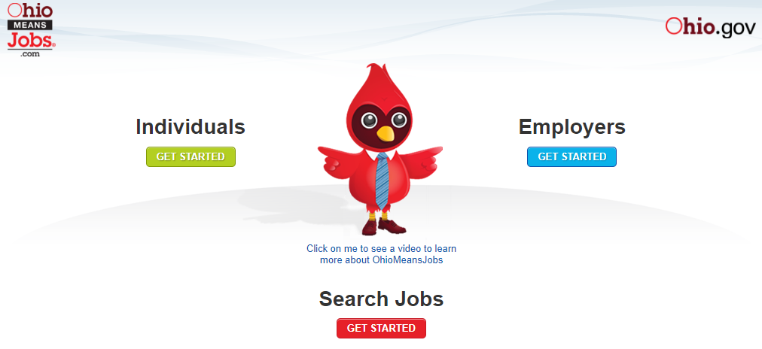
OhioMeansJobs.com
Website providing self-service tools
  Job seekers
    Resume Builder
    Self-Assessments
    Budgeting Tool
    Interview Tool
  Employers
    Labor Market Information
    Job Board for posting open positions
    Candidate Pool for potential applicants

Slide 4
Who are we?
Local “franchise” of the American Job Center (AJC) Network
  Formed within Workforce Innovation and Opportunities Act (WIOA)
    Funding from the US Department of Labor
    Through Ohio Department of Job and Family Services
    Locally (Area 11) – Workforce Development Board of Central Ohio
  AJC’s are “One-Stop” offices to focus on employment through collaboration
    13 required community partners
    Unlimited optional partners

Slide 5
Our “Why” Statements
OhioMeansJobs Columbus-Franklin County
To deliver high quality services to individuals living in Franklin County and surrounding areas to prepare them for available careers that will provide gainful employment and connect businesses to skilled workers.

Slide 6

How do we approach our work?
Resource Center
Workshops
Career Counseling
Veteran Services
Adult Education Classes
Occupational Skills Training
Networking Opportunities
Business Solutions
Community Events

Slide 7
Resource Center
Everything you need to assist in your job search
  24 Computers
  Fax Machine
  Printers
  Resume Builder
  Labor Market Information
  Job Search Tools
  Assistance with OMJ website

Slide 8
Workshops
Resume
Interviewing
Job Search
Computer Basics
Microsoft Office
How to use OMJ
OMJ Orientation
Road Maps to Success
Job Club

Slide 9
Career Counseling
Individualized sessions focused on your career goals
  Career exploration
  Job search
  Interview practice
  Creation of an Individual Employment Plan
  Skill enhancements
  Supportive services

Slide 10

Veteran Services
Services focused to assist with unemployment and underemployment
Services are geared towards the needs of eligible veterans and veterans’ spouses
Services utilize a network of partners to encourage long term success and career stability

Slide 11

Adult Education Classes
ASPIRE Classes are provided through Columbus City Schools
Available onsite two days a week
Focus is on GED attainment or preparation for post-secondary training

Slide 12

Occupational Skills Training
Focus on enhancing skills for high demand jobs within Columbus/Franklin County
Types of programs
  Degrees
  Certificates
  Licensures
Tuition assistance may be available

Slide 13

Networking Opportunities
Networking/Job Club
  Focus on understanding the importance of a network
  Non-traditional job search methods
  Learn what human resource professionals are looking for
  Understand how to target employers and skill market yourself

Slide 14

Business Solutions
Assist in connecting employers with employment ready candidates
Provide current labor market information
Provide support on OhioMeansJobs.com
Provide opportunities for On-the-Job (OJT) Training projects

Slide 15
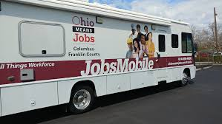
Community Events
Connect with job seekers in the community
Provide information on services
Resume assistance
Connect job seekers with resources for success

Slide 16

Community Events

Slide 17
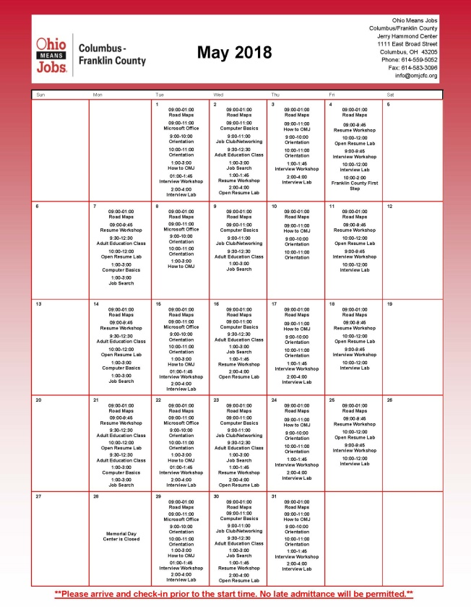
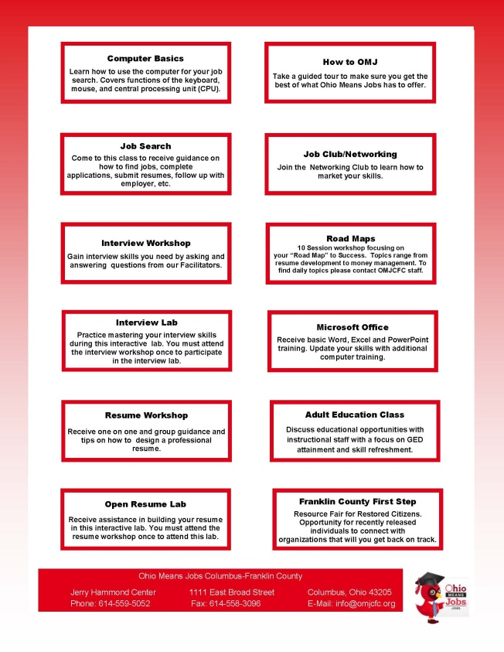

Key Resources

Slide 18
Questions?

